Slide 1

SUDOKU
Mini Project - I

Slide 2
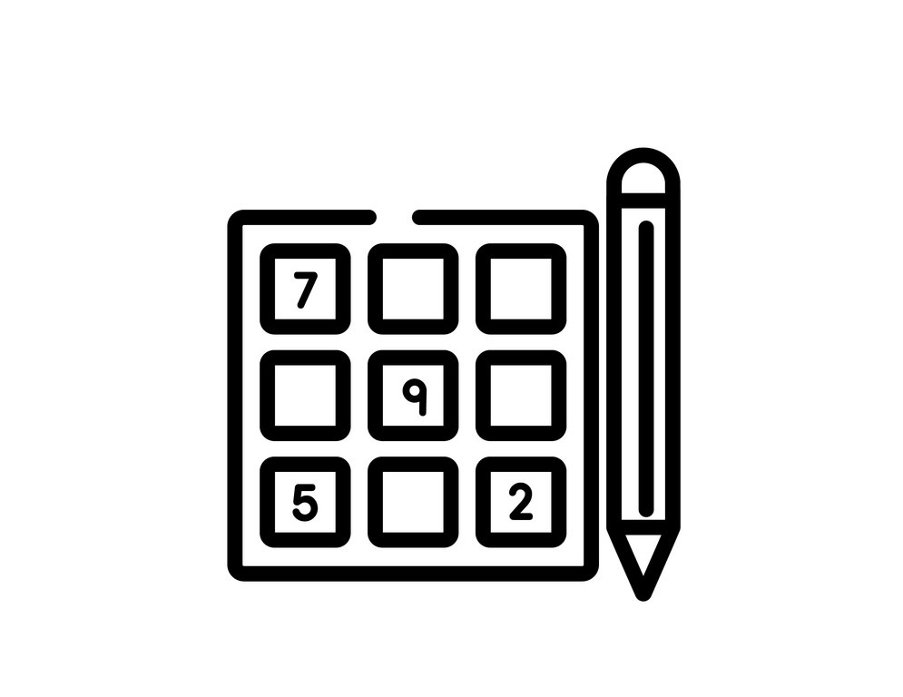
Presented By
Chandra Kiran Reddy [ 1602-20-737-008 ]
Harsha Vardhan [ 1602-20-737-015 ]
Pranay Kumar [ 1602-20-737-028 ]

Slide 3
Abstract
The main objective of the project is to provide a logic-based game. This project is useful for any kind of people especially young minds who wants to improve their problem-solving skills. And we have also implemented a sudoku solver which takes a sudoku board as input and finds solution if it is solvable.
When the game starts, a menu is shown. The player must select whether to solve a puzzle or would like to find a solution for one.
If player selects to solve a puzzle, then a puzzle is generated and is shown to player. If player selects to find a solution, then an empty puzzle is generated, and the player must give input and the solution will be displayed right away.

Slide 4
Technology Used
Tkinter and pygame for Building the GUI
01
From tkinter we have used Button, Label , geometry and config methods.
02
From pygame we have used time, draw, font , display, KEYDOWN methods.
03
Backtracking method to solve the sudoku
04

Slide 5
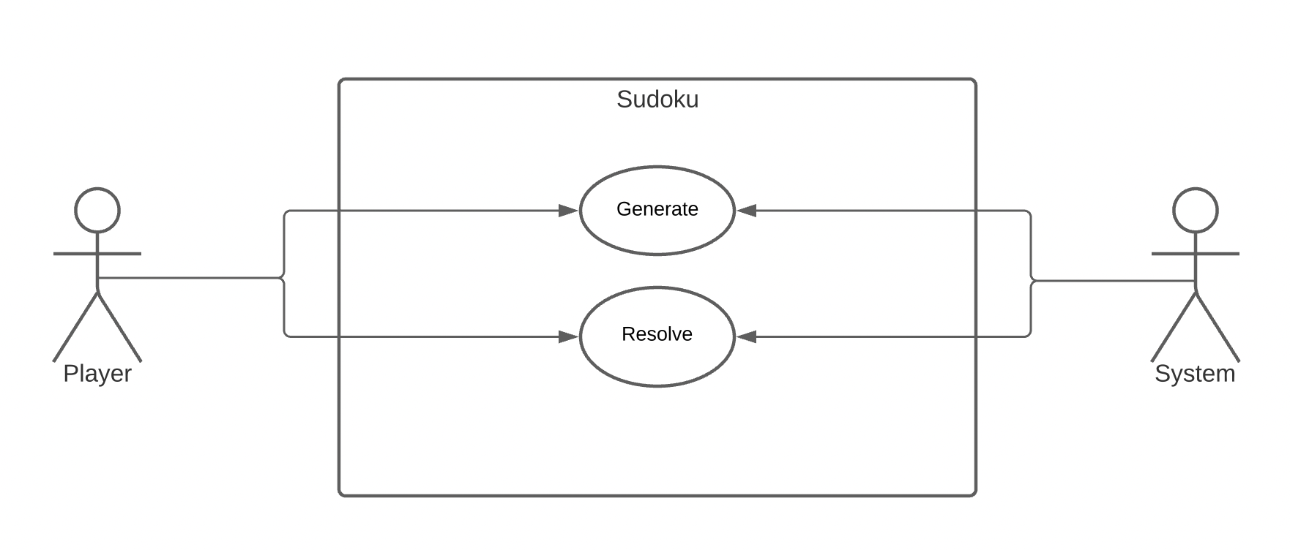
Use-Case Diagram

Slide 6
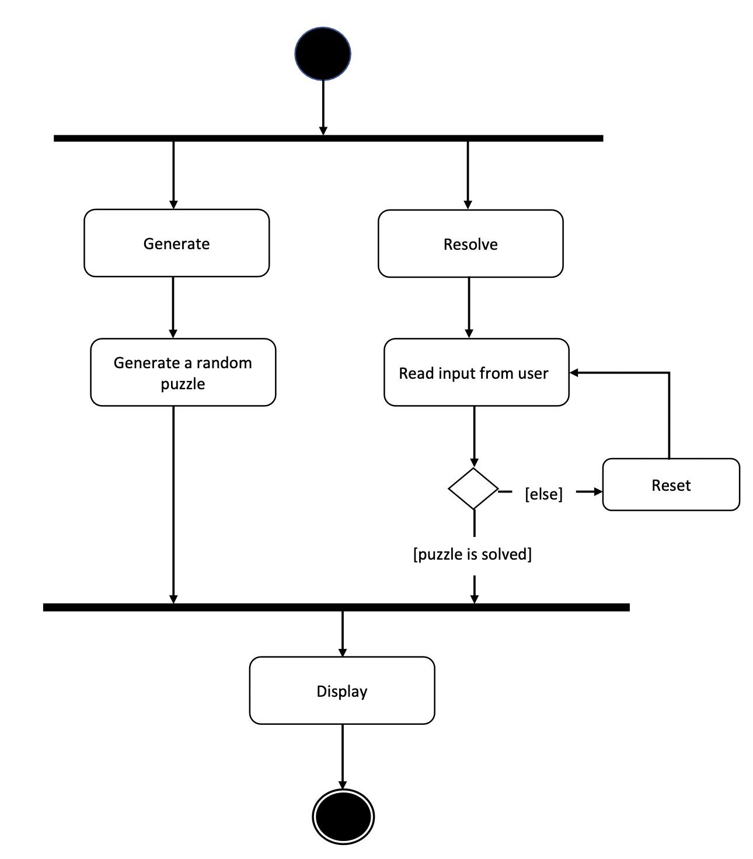
Activity Diagram

Slide 7
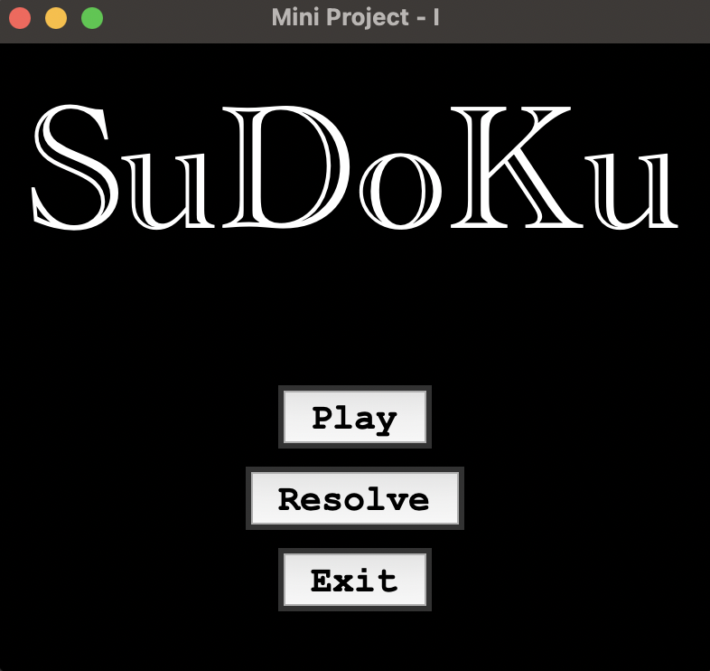
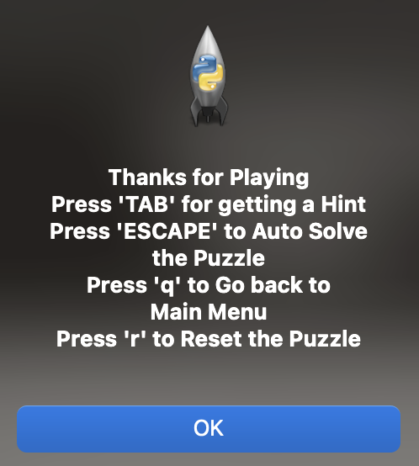
Result
After running the code, a new page is popped up with title “Mini Project - I”
If we click on play button, a message box is popped up stating all the keys used.
Then, we must click on ‘ok’ button and then sudoku puzzle is displayed.

Slide 8
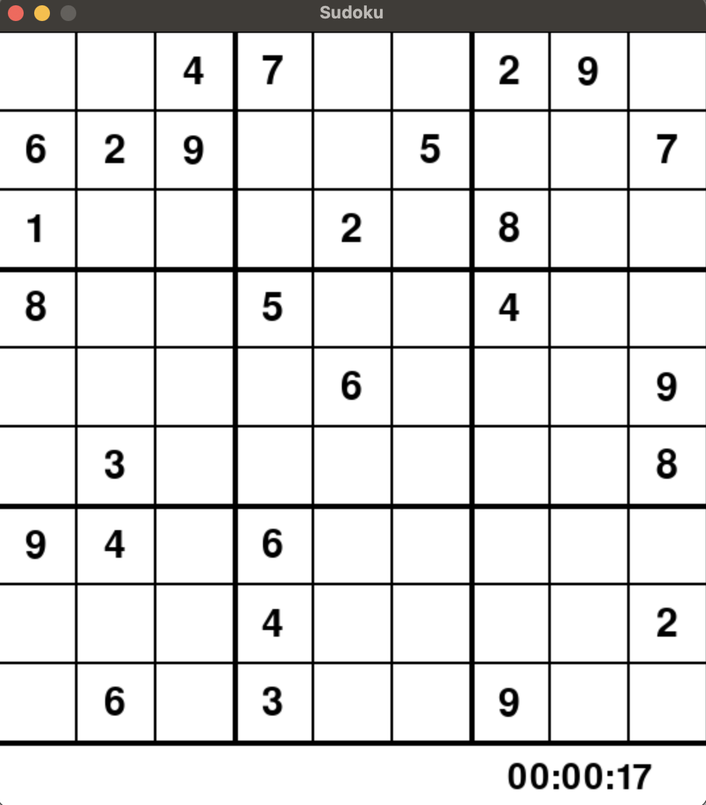
Player can start fill the puzzle and can check whether the entered number is correct or not by clicking the “ENTER” button.
Player can also get a random box filled as a hint by clicking the “TAB” button.
If player cannot solve the sudoku puzzle, then player can click the “ESCAPE” button and system automatically solves the puzzle.
Player can also rest the board by clicking “r” button.
Player can also quit by clicking “q” button.

Slide 9
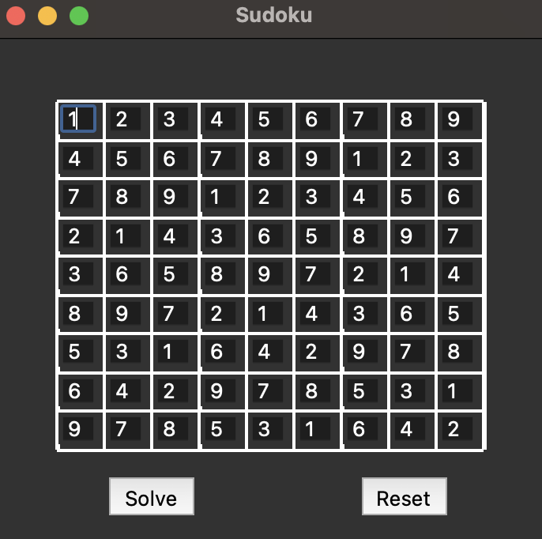
After quitting the play mode, the menu will appear and we will now click on resolve button, which helps in finding the solution for puzzle entered by players.
Here I have entered 1 and clicked on solve button. Then this is the output.
If you enter a number same number in a row or column or in a square, then a warning box popped up.
Now if you enter a character, then a warning box is popped up.

Slide 10
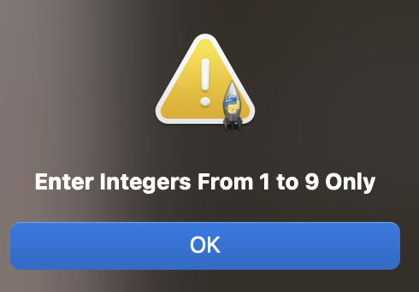
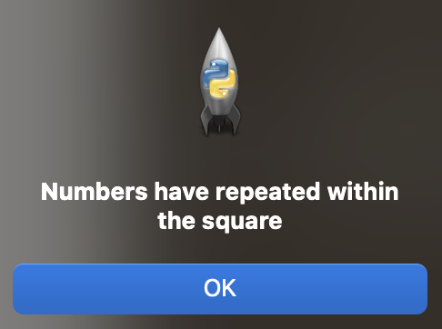
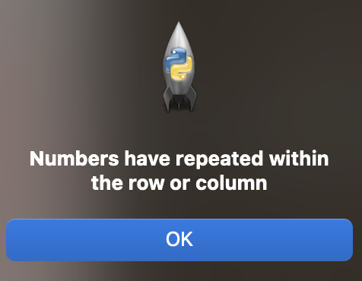
If we click on cross button, then we can come back to main menu again.
Then if we click on ‘exit’ button, program is terminated.

Slide 11
Conclusion
As we know Gaming is one of the largest segments of the entertainment industry. It is a demanding career in today's modern world. With the wide access to the internet has created a humongous demand for online games and with the advent of technology, this industry is growing at fast pace.
So, this kind of logic-based games still have a scope in future world.

Slide 12
Future Scope
[ 1 ]
Include levels like Easy, Medium and Hard for Play Option.
[ 2 ]
Include AI for scanning and reading input from an image or directly from camera and find the solution, respectively.
[ 3 ]
Improve User Interface.
[ 4 ]
Include Leaderboard based on time taken to solve the puzzle.

Slide 13
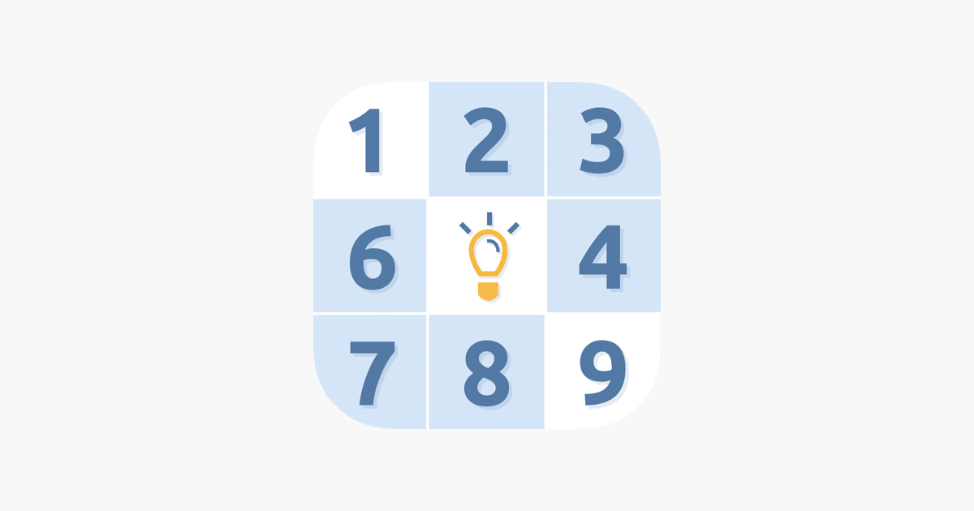
Thank you

